Slide 1

What can you do with a Raspberry Pi for Ham Radio?
Randy Wilkinson
W4LKS
Washington Digital Radio Enthusiasts ARC

Slide 2
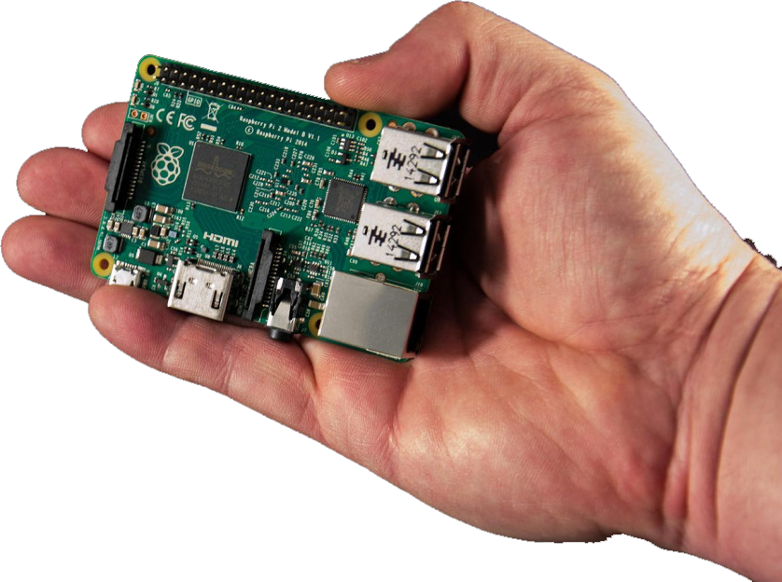
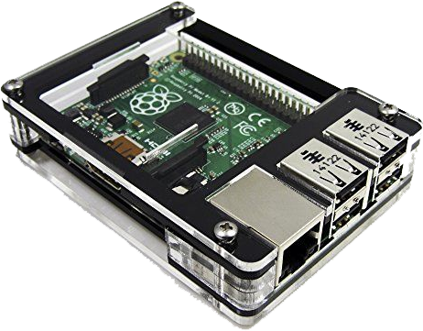
What is a Raspberry Pi Computer?
Credit card sized single board computer
ARM Processor
Limited memory, not expandable
Low power consumption, USB cable
MicroSDHC card for Hard Drive
USB ports for peripherals
HDMI port for monitor and sound
GPIO pins for external I/O
Poor Quality Sound Card
Debian derived Linux Operating
System (usually)
List Price: $35
Notes:
Short explanation of the HARDWARE part of a Raspberry Pi
What do you get for $35
The bottom photo shows an RPi with an optional C4LABS plastic case.
I buy mine from: https://www.newark.com/

Slide 3




What models were made?
Original RPi Model B:
  Released Spring 2012
  700 Mhz single processor
  256 MB RAM
  SDHC card for Hard Drive
  2 USB ports
  100 Mbps Ethernet
RPi 2 Model B+:
  900 Mhz Quad Core processor
  1.0 GB RAM
  MicroSDHC card for Hard Drive
  4 USB ports
  100 Mbps Ethernet
Not Recommended
RPi 3 Model B+:
  1400 Mhz Quad Core processor, 64 bit
  1.0 GB RAM
  MicroSDHC card for Hard Drive
  4 USB ports
  100 Mbps Ethernet
  802.11 b/g/n WiFi and Bluetooth LE
RPi Model B+:
  700 Mhz single processor
  512 MB RAM
  SDHC card for Hard Drive
  4 USB ports
  100 Mbps Ethernet
Notes:
Raspberry Pi Hardware History – You need to know where it came from
All were sold for $35
Not included here: RPi Zero, and Specialized models like A and Compute Modules.

Slide 4
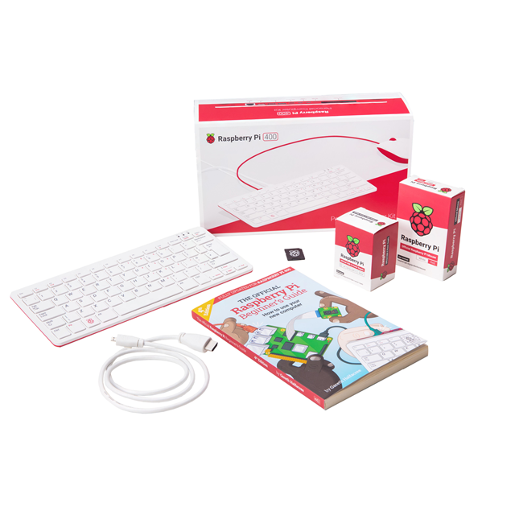
What models are made?
RPi 4 Model B+:
  1500 Mhz Quad Core processor, 64 bit
  MicroSDHC card for Hard Drive
  4 USB ports, 2 are USB 3.0
  1000 Mbps Ethernet
  Dual band wifi + Bluetooth
  2 HDMI video ports supporting up to 4k resolution
  Available with 1GB RAM, 2GB RAM, 4 GB RAM, 8 GB RAM
  $35 to $75
RPi 5 Model B:
  Similar to RPI 4, but faster
  Optional super fast SSD hard drives
  Up to 16GB RAM
  Up to $120
RPi 500 Kit:
  Just need monitor
  or TV
  $120
Notes:
Raspberry Pi Hardware History – You need to know where it came from
All were sold for $35
Not included here: RPi Zero, and Specialized models like A and Compute Modules.

Slide 5
OS Software
Debian Linux – Raspberry Pi OS
  Latest Linux kernel and OS components
  Current version is based on Debian Bookworm (supports RPi5)
  On-Line repositories of thousands of software packages
  Available programs are easily installed
  Aptitude manages software installation
  Other programs through 3rd party repositories and .DEB files
  Downloadable as bootable image
Dragon OS
  Based on latest Ubuntu Linux
  Purpose built for SDR radios and ham software
Notes:
Operating System Software.
All hardware versions except RPi3 worked OK on Raspian Wheezy
RPi3 requires Raspian Jesse

Slide 6
Ham Radio Applications
Digital Voice Hotspot
Digital Voice AMBE Dongle
AMBE Server
D-RATS
Repeater Controller
IRLP node
Packet Radio / APRS
Rig control
CHIRP
Software Defined Radio-YES!
But wait…there’s more
  D-STAR
  DMR
  Fusion
  P25
  NXDN
  M17
  POCSAG
Notes:
The applications we will be talking about.

Slide 7
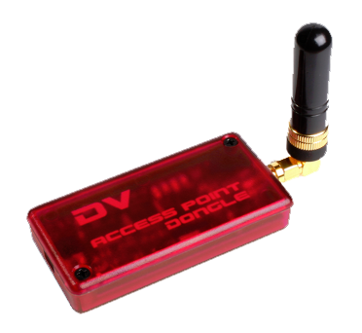
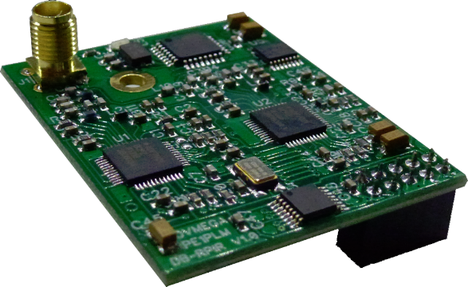
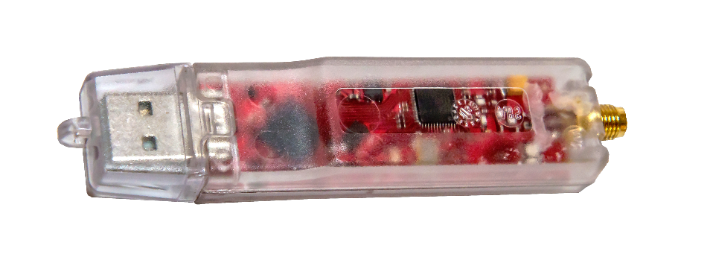
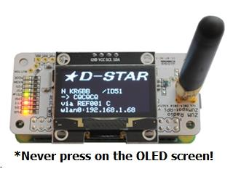
Digital Voice Hotspot - Hardware
DVMega RPi HAT
RPi Computer with:
  DVAP (MMDVM software)
  DVMega (MMDVM software)
  MMDVM HAT (Simplex or Duplex)
  ZUMSpot/JumboSpot (MMDVM software)
On-Board low power radio transceiver, 10 mW
Use with your DV transceiver
Create your own DV mini-repeater, simplex
Connect to any repeater or gateway through
your home Internet
Original DVAP
DV4Mini
ZUMSpot
Notes:
DV Hotspot HARDWARE

Slide 8
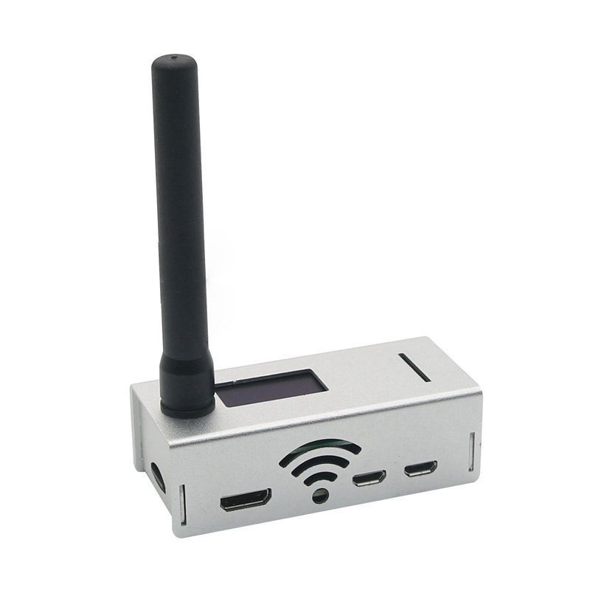
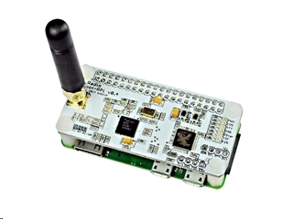
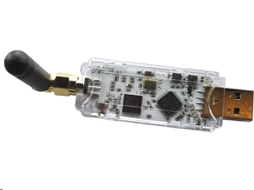
ZUMSpot / MMDVM DV Hotspot - Hardware
Raspberry Pi with ZUMSpot Radio Board
Newer boards: MMDVM_HS_HAT
All work with Pi-Star Software
Most use STM32 microcontrollers and
Analog Devices ADF7021 radio chips
JumboSpot - Chinese Clone of ZUMSpot
RPi Zero 2W with ZUMSpot Board
ZUMSpot USB
Notes:
ZUMSpot boards and accessories are available from Ham Radio Outlet
JumboSpot devices are usually purchased on eBay or AliExpress
SharkRF devices are not RPi so not discussed here

Slide 9
Digital Voice Hotspot - Software
Pi-Star Software from Andy Taylor – MW0MWZ
  Image for Raspberry Pi SDHC Card
    Easy setup. Up and running in 30 minutes.
  MMDVM Software from G4KLX
    Provides all the popular DV formats
  Wide support for hotspot hardware
  Excellent dashboard
  Web Browser based configuration and operation
  V4.2.X not yet working for Rpi 5 (requires Bookworm)
  Forked versions from Chip (WPSD) and others
  A great alternative to RPi based hotspots is SharkRF OpenSpot
Notes:
Newest and most preferred DV Hotspot SOFTWARE
Get it from https://www.pistar.uk/
Other hotspot software for Rpi: Tom Early’s (N7TAE) QnetGateway
SharkRF devices are great, but not Rpi based so not included here

Slide 10
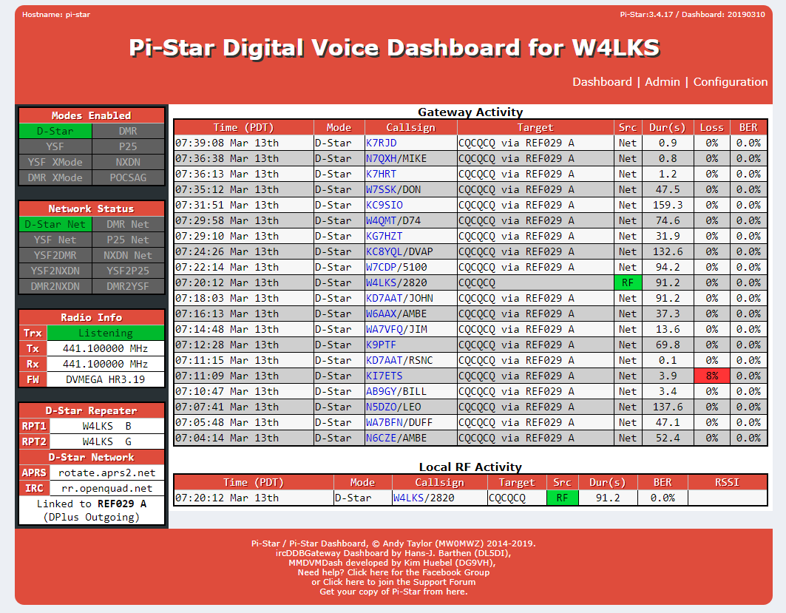
Notes:
Screen shot of Dashboard page
This dashboard shows only D-STAR keyups…You can configure to show key-ups for DMR, Fusion, P25, etc

Slide 11


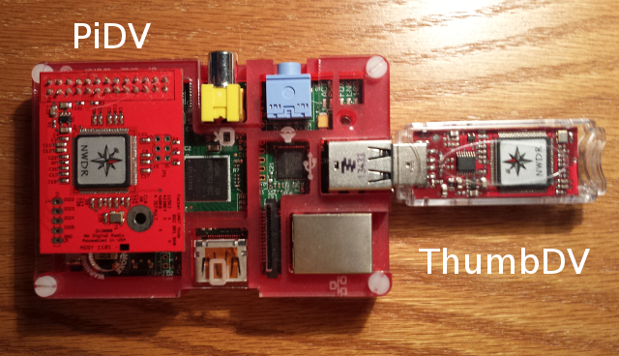
DV AMBE Dongle
DV with NO radio transceiver.
  Internet Labs DV Dongle ($190)
  Internet Labs DV 3K Dongle ($150)
  NWDR ThumbDV ($120)
  NWDR PiDV ($100)
  DVMega DVStick 30 ($130)
Has AMBE vocoder on-board
Plug into USB port
Use your computer Mic/Headset
as transceiver, even Android phone
Use Blue DV Software for Android and Windows PCs
Notes:
NWDR ThumbDV highly recommended. Get’m here: http://nwdigitalradio.com/shop/
Get Blue DV software here: http://www.pa7lim.nl/bluedv/

Slide 12

AMBE Server
Allow use of a single AMBE chip to be shared over your network
Use RPi, ThumbDV or PiDV, and ambeserver software
Connect to server from any computer on your network using G4KLX’s dummyrepeater

Slide 13
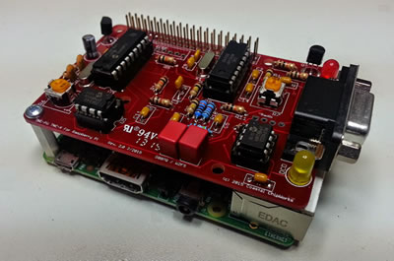
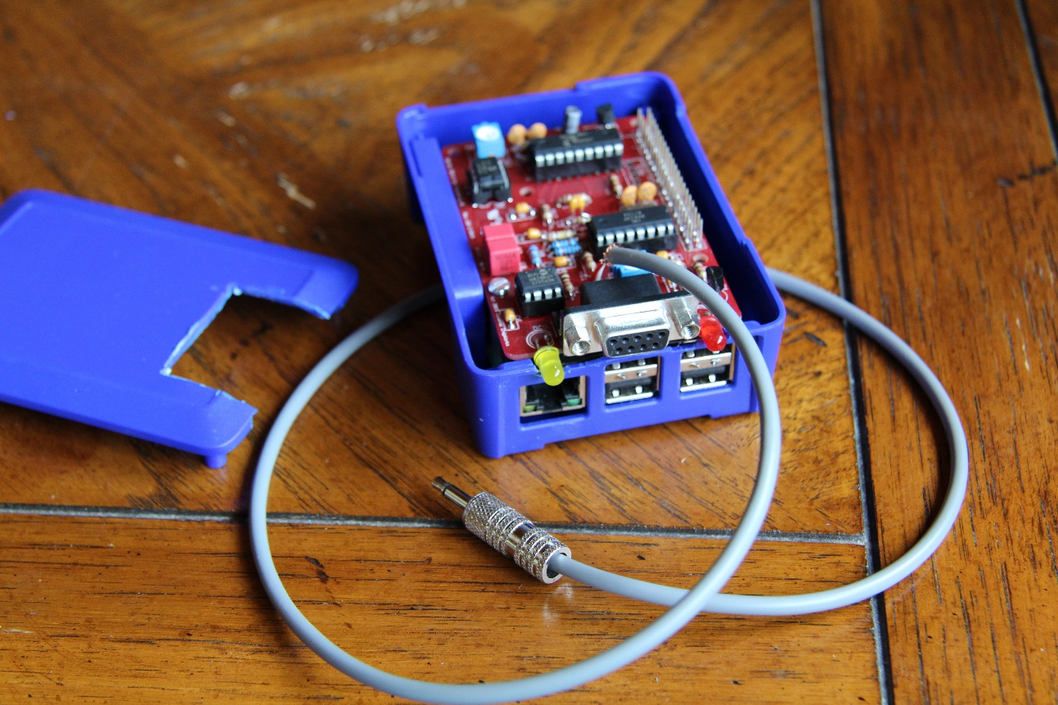
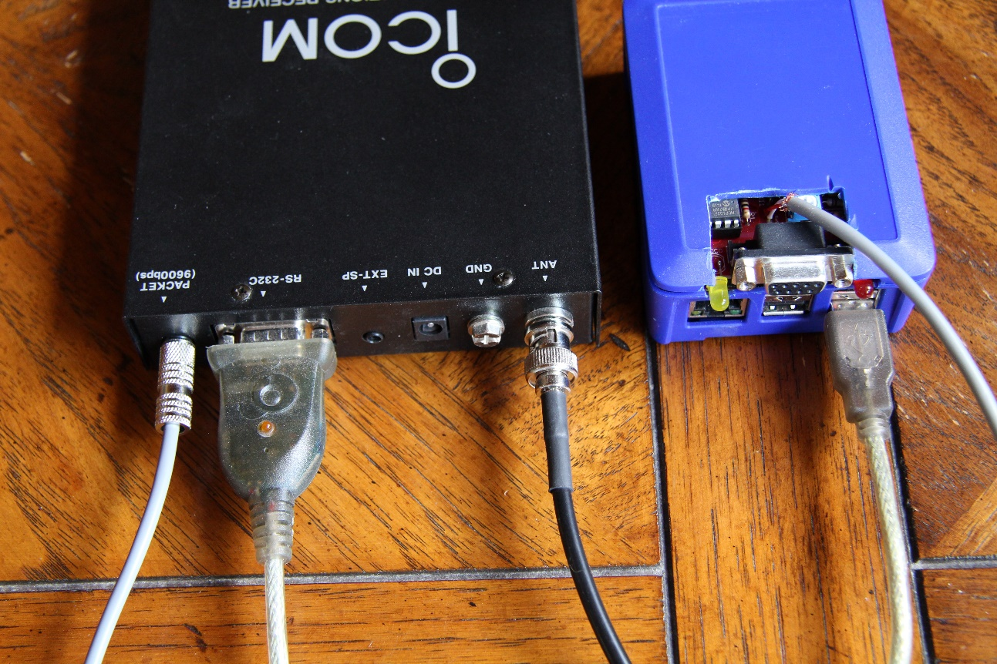
Packet Radio
TNC-Pi ($40 Kit, $65 assembled)
APRS applications
Winlink, Other applications?
Notes:
Here is my Coastal Chipworks TNC-Pi, connected to my ICOM PCR-1000 computer controlled receiver. The Pi is not only the TNC host, also operates the tuner within the receiver.
This setup would be Rx only

Slide 14
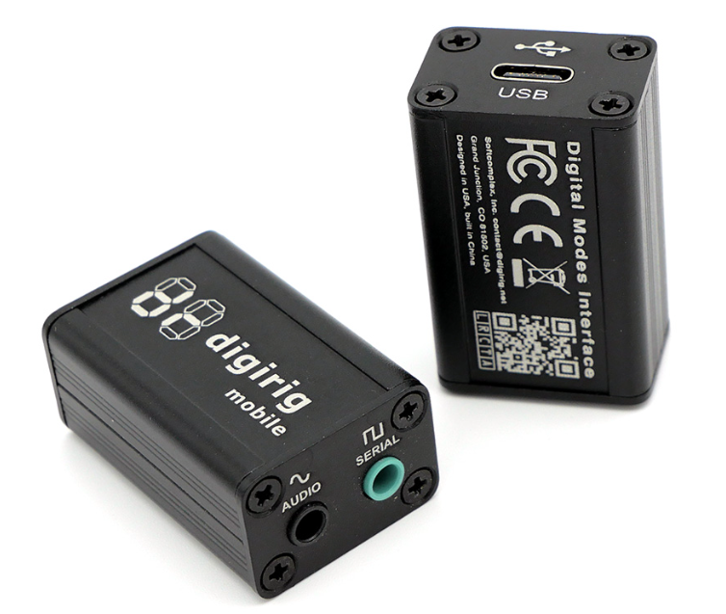
Packet Radio
USB based TNC & Rig Control
Digirig Mobile ($50)
  Cables extra
Winlink & Vara on RPi
Notes:
For a Rx AND Tx packet radio setup, including rig control…DigiRig would be great.

Slide 15
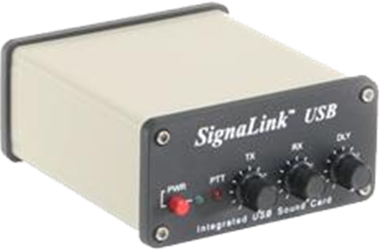
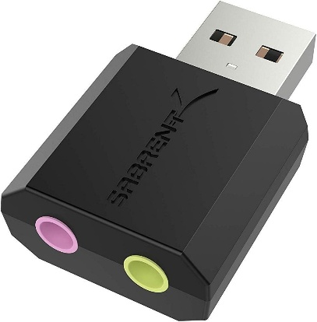
APRS
Linux Software:
  Xastir
    Graphical, map based APRS display, i-gate, messaging
    BYO TNC
    Old-ish GUI
  YAAC – Yet Another APRS Client
    Java based, platform independent
    Very nice maps
  Direwolf
    Software and soundcard based TNC
  APRX - Linux based Digipeater, i-gate
  Aprsg -Simple i-gate runs as a background service
Notes:
If you have a TNC, here is some APRS software to use with it.
Remember, the built in Rpi sound card is horrible. For Software base TNC (direwolf), use a USB sound card or signalink.

Slide 16
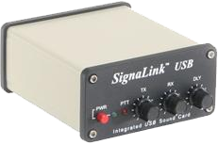
Rig Control –and digital modes
FLDigi
  Easily installed from the usual software repository
  Need USB sound card (Signalink, DigiRig, etc.)
  Does all the usual digital modes (PSK31, RTTY, etc)
  Large list of HF rigs can be controlled
  QSO and Contesting Logging
  Easily controlled remotely using VNC
WSJTX
  JT65, FT8, etc.
Notes:
A Signalink works well with an Rpi, costs about $120 new.
The drivers for it are in the Linux Kernel.

Slide 17
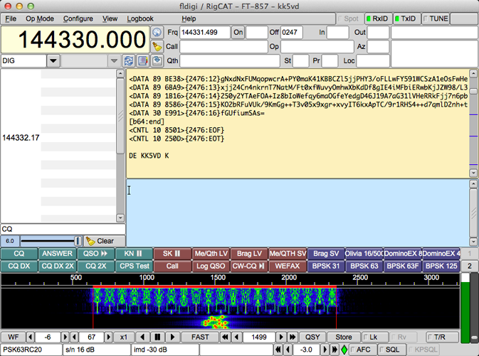
Notes:
MacOS version shown…RPi version is similar.

Slide 18
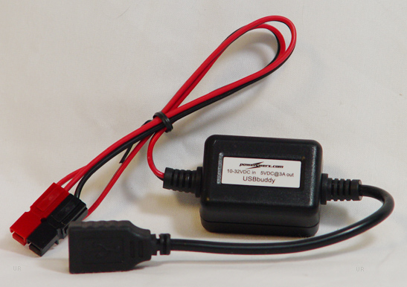
CHIRP
Written by Dan Smith, KK7DS
Amateur transceiver memory programming
Wide assortment of supported radios
Import frequencies from RFinder, RepeaterBook, etc.
Written in Python, works on any platform
Works great on Raspberry Pi
USBbuddy from Powerwerx
Provides USB power from your car to run an RPi.
Notes:
You could run a headless RPi3 (or any RPi with WiFi) in your car, with a serial connection to your mobile radio, and sit in your nice warm house while you program frequencies into you mobile transceiver. You just need to know the IP address of the RPi and use VNC to connect to it remotely over your WiFi.

Slide 19
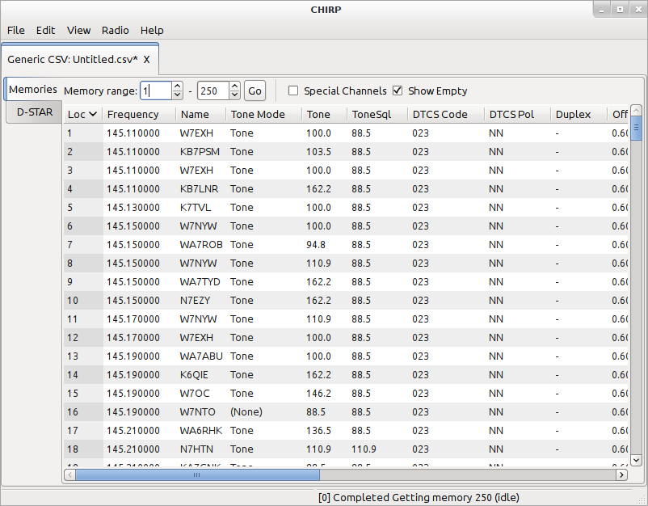

Slide 20
73Linux
From Jason - KM4ACK
Formerly called Build-a-Pi
Add to your existing Debian based Linux for Pi or PC
Includes installers for VARA and Pat Winlink
Good APRS support
Run the installer script and choose your software
Most software is downloaded as source code and compiled
Notes:
What else can ya do?

Slide 21
DragonOS
Large image of RPi operating system (4GB), based on Ubuntu
Burn image to SD card or NVME SSD drive
Tons of ham Software pre-loaded, ready to use
Emphasis on SDR software to support RTL-SDR, SDRPlay, Etc
CubicSDR, GNU Radio, Gqrx, SDR++, PySDR, SDRAngel
Of course it has WSJTX and JS8CALL built-in
And a great general purpose OS for the RPi4 and RPi5
Notes:
Errrgh…No SDR Console
Works best on RPi4 and RPi5 with 4GB RAM or more

Slide 22
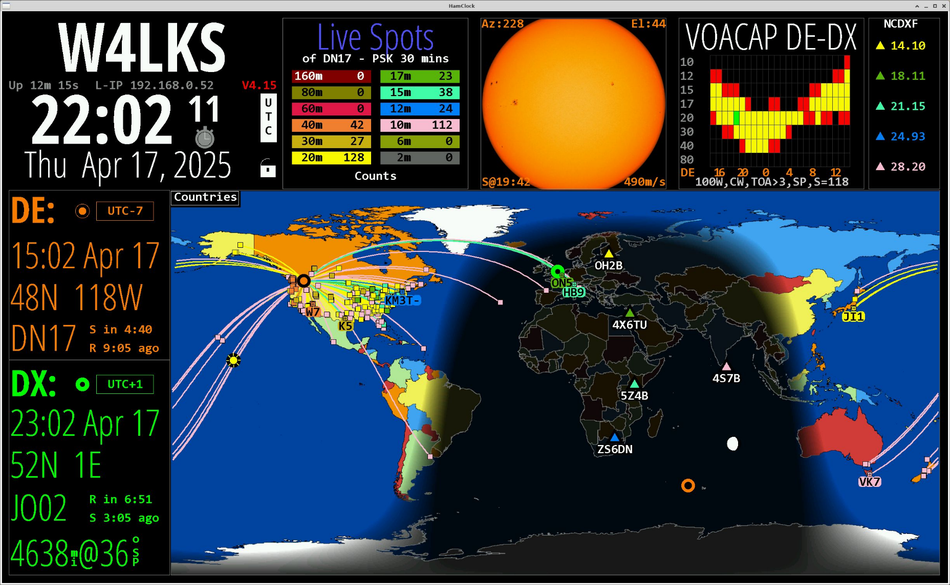
Ham Clock
Notes:
What else can ya do?
Ham Clock works great on RPi…in a window on your monitor, or full screen on a giant 4K TV
Similar to GeoChron

Slide 23
Other Ham Radio Applications
TAPR WSPR-Pi 20M QRP Transceiver
ADS-B Aircraft tracker using an RTL-SDR dongle - FlightAware
Simple Low power FM-Wide Transmitter
Echolink using SVXLink software. Quad core Pi only.
RPi based analog repeater controller using SVXLink hardware
  openrepeater.com
Antenna design
Satellite tracking
Lots more! 129 packages under “Amateur Radio” in Linux Mint

Slide 24
73 de W4LKS

